Slide 1
What is AISG
SW / RF Test
DEC 2019

Slide 2
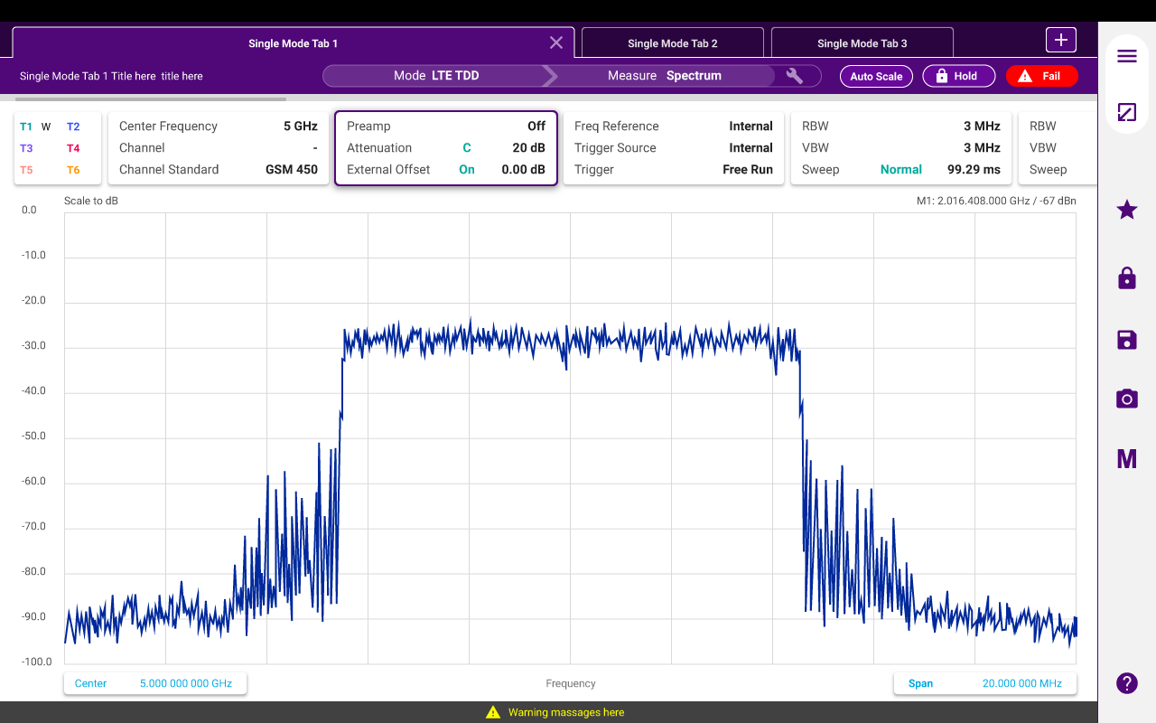

What is AISG?
UI/UX composition
Framework (1)
Basic frame for app.
Menu, file manage, marker
Various tools, etc.
Measurement applications (2)
Spectrum, RtSA
IA, CS, LTE, 5GNR
etc.
1
2

Slide 3
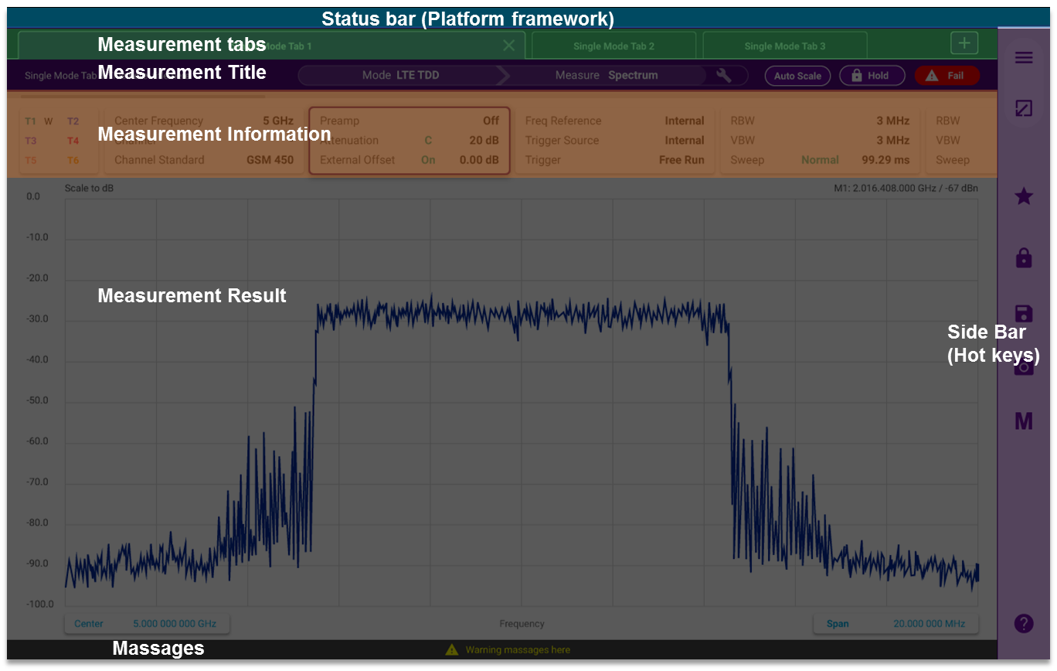
표준 동향 AISG1.1, AISG2.0, AISG2.1
CA5000 is A solution sw running on advisor platform
Platform Area
1
2
3
4
Allocated to Solution SW
after launching Solution SW
5
6
7
Area | Description
Platform bar (1) | Platform service
Measurement Tab (2) | A measurement (title / information / result), multiple taps support
- Measurement Title (3) | Identify & change current measurement
- Measurement Configuration (4) | Identify & change configuration
- Measurement Result (5) | Test result & analysis
Side Bar (6) | Menu, hot keys, help
Message (7) | Messages

Slide 4
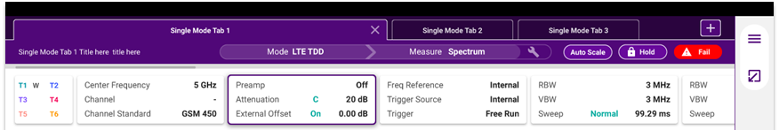

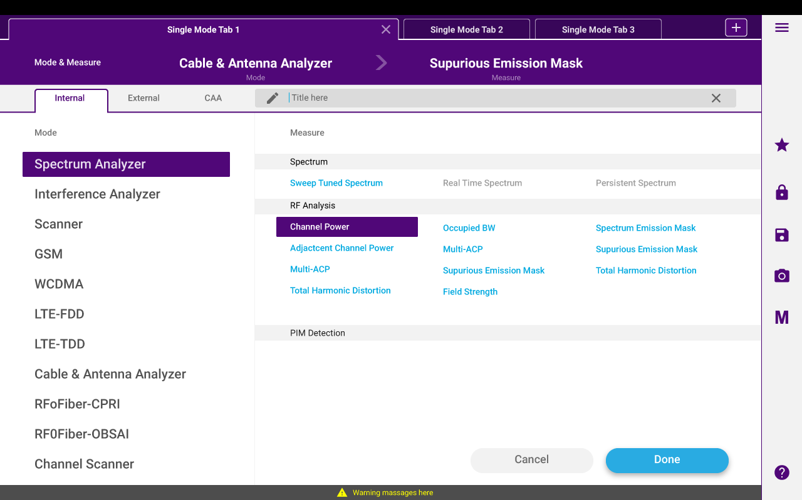
Use Case Antenna control
Tabs
Tab : Basic unit of measurement
Creation (1) & Change (2) of measurement
Title
1
2
Mode
Measurements of Mode

Slide 5

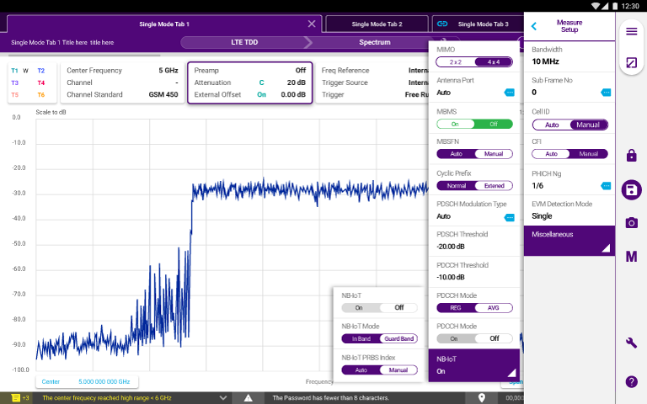
Layer별 역할 Layer1, Layer2 and Layer7
Configuration group
Screen size limitation - Use sliding gesture (1)
Quick access to change configuration (2)
1
2

Slide 6
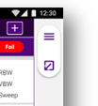
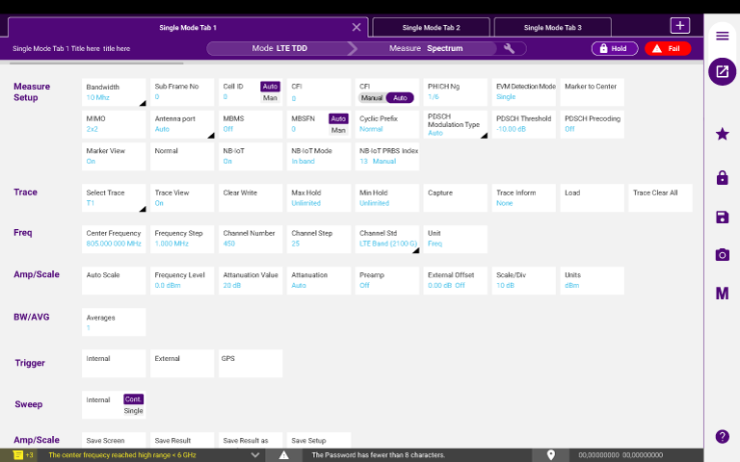
HDLC Basic
Menu (Popup, 1)
No hard key matched to menu
Maximize result area
Difficult to find a menu
Full screen menu (2)
Quick & easy to find a menu
Batch configuration
Without menu navigation
1
2
Three ways to configure measurement
Touch configuration area
Touch Menu button
Touch Full screen menu

Slide 7
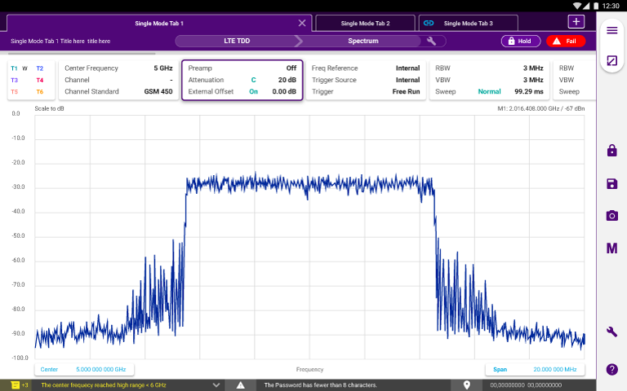


Protocol
Touch Gesture support
Center frequency change (1)
Reference level change (2)
Span Change (3)
Quick change Center/Span frequency (4, 5)
1
2
3
4
5

Slide 8
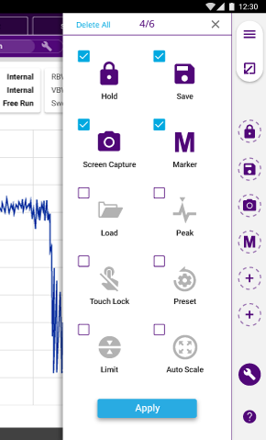
실제 구동 예 SS BBUe
Hot keys (1)
Frequently used actions
Suggested actions (Common)
Quick save as screen, trace, …
Quick save all
Hold (run/stop)
Marker / Peak
Save, Load
Preset
etc
Customized by user (2)
1
2

Slide 9
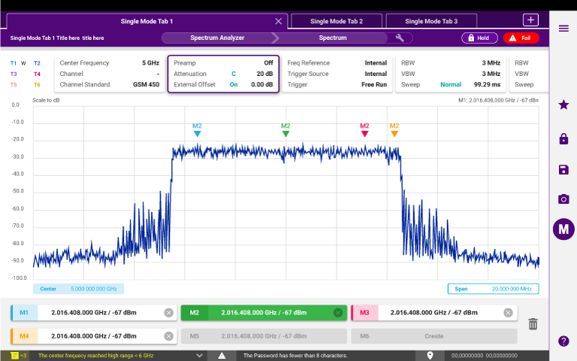
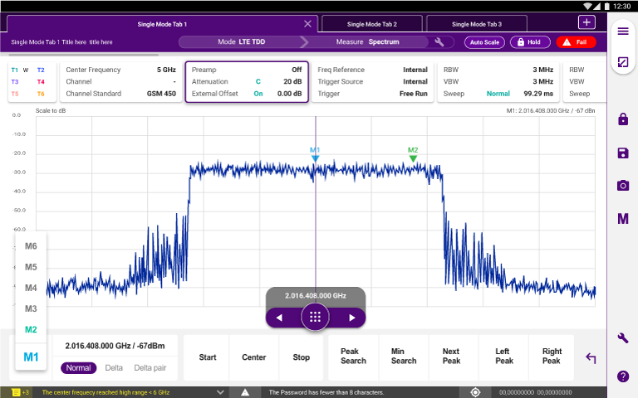
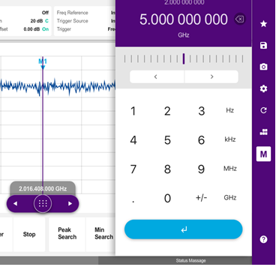
Application
Marker table On (1)
Marker value change (2)
Sliding for coarse (3)
Arrow key for fine (4)
Manual Input (5)
Peak operation (6)
1
2
4
5
3
Soft keypad
6
Slide Bar

Slide 10
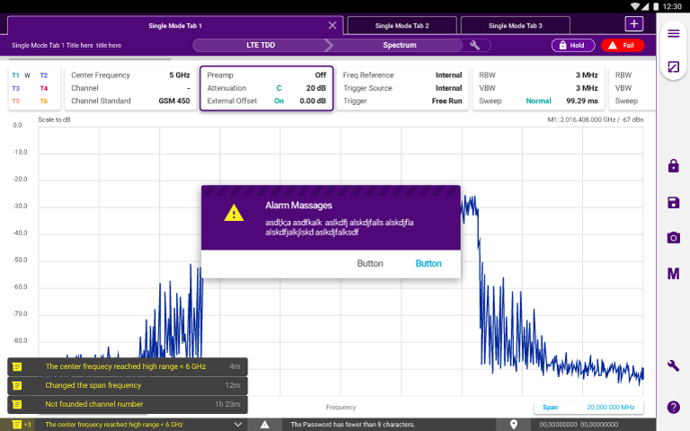
Q&A
Toast / Persistive message
Toast (e.g. Invalid Input/operation) – (1)
Persistive (e.g. Guide to induce user action) – (2)
1
2

